Slide 1
Week 9 CIS 215
Disaster recovery

Slide 2

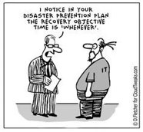
What is disaster recovery?
Disasters such as accidents, acts of nature etc. Need to have a plan in place to recovery from that
Assume nothing will work, you can't rely on your current system, communication, phone or anything
Think about natural disasters such as snow storms, hurricanes and what the plan is if your company is in the path of that

Slide 3
Who makes the plan?
C Suite people
IT people
Sales
Accounting and finance
Basically everyone from every place you picked for a CERT team you'll need here
Including an alternate (just like for CERT) in case of emergencies, to have a backup and make sure there are no bottlenecks of knowledge

Slide 4

What should be on the plan?
Hardware
Software
People
Backups
Testing
Who watches the watchers?
https://www.deviantart.com/loopydave/art/Quis-custodiet-ipsos-custodes-585769371

Slide 5
Hardware
What if the hardware disappears (fire, flood, etc)
Onsite vs Offsite
Rentable disaster recovery hardware
Companies making agreements with other companies as backups
If NECC loses power, what happens to our servers? Well we actually run a lot through other schools, so they can be a backup. Conversely we can be backup for someone else.
Side note, this can create issues if the agreements aren't documented well and the person/people who made them aren't there or forget to pass along the message

Slide 6
Software
Backing up of software and programs not just the data
Byte by byte backups vs incremental backups
Different backups at different times
Such as once a day back up new data, once a week back up new data and programs, once a month back up everything byte by byte.
Backup what you're not willing to lose and set your backup to happen as often as you are willing to redo work (you're willing to redo a day of work? Backup once a day, willing to lose an hours' worth? Back up every hour)

Slide 7
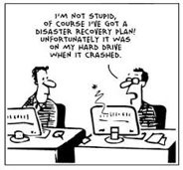
Backups cont.
What medium are you using for the backup?
How long does that medium last?
How long do you need to keep your backup?
How is it protected?
How is it encrypted?
Who has access?
How is it verified and tested?
Do you back up your backups?
On site vs offsite backups
Third party vs in house backups

Slide 8
People
Never have 1 person in charge of so much they are the single point of failure. Your plan should NEVER be "that person"
Need info on each of the systems
Need passwords, who knows them? Who's the backup? Where are they written down? How often is the backup updated (Spoiler: Should be updated whenever the password or plan changes)
Need someone that knows the infrastructure
What's your business continuity plan?

Slide 9
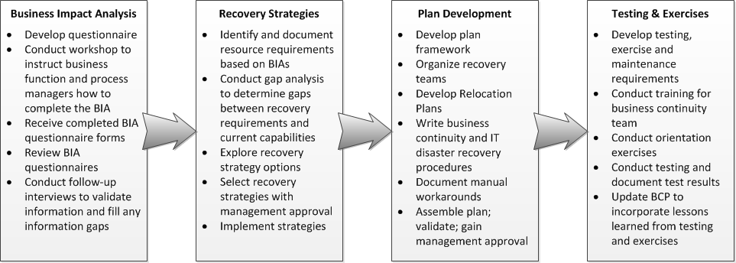
Business continuity plan
https://www.ready.gov/business-continuity-plan

Slide 10
How do we test the plan?
We need to run simulations and war games. We don't know if our plan works unless we test it
Ex. We put our whole plan in a binder in a locked safe that we can all get to. Yay? What if there is a fire and we evacuate the building(s). Where is our backup of the plan? Who knows what we do next?
We should test once a year at minimum.
When we find errors we need to update the plan AND the documentation of the plan

Slide 11
Disaster Recovery Checklist example
https://inside.sou.edu/assets/it/docs/disaster-recovery-plan.pdf
https://www.cisco.com/en/US/technologies/collateral/tk869/tk769/white_paper_c11-453495.pdf
https://www.nasa.gov/sites/default/files/3-2a-divya_disaster_recovery_1.pdf

